Slide 1
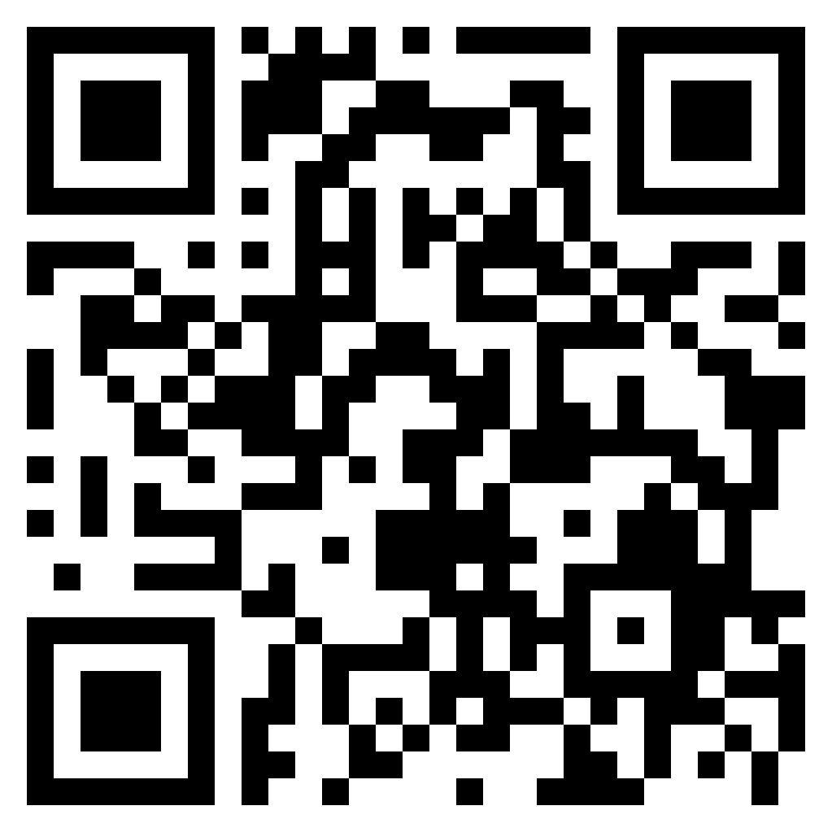
Convolutional Neural Networks
tg: @naconov, @zamyrailov
GitHub: NasonovIvan, maykitbo

Slide 2
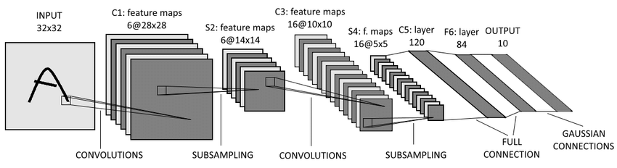
Convolution

Slide 3
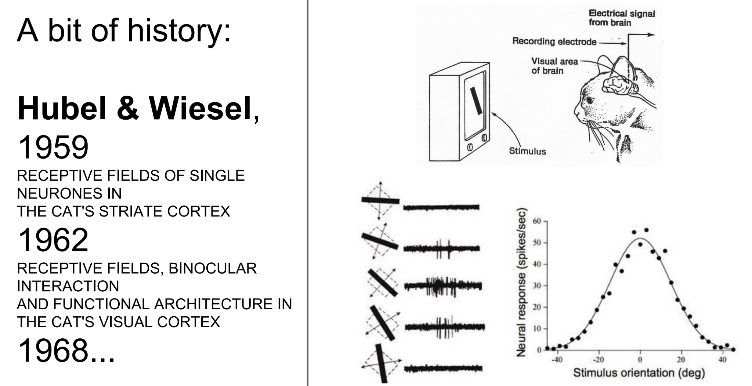
Convolution
Stanford CS231n

Slide 4
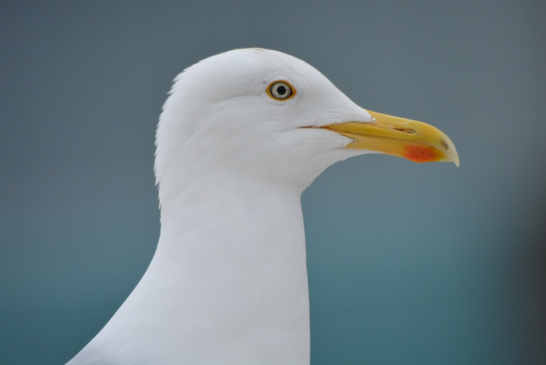
Convolution
Girafe AI

Slide 5
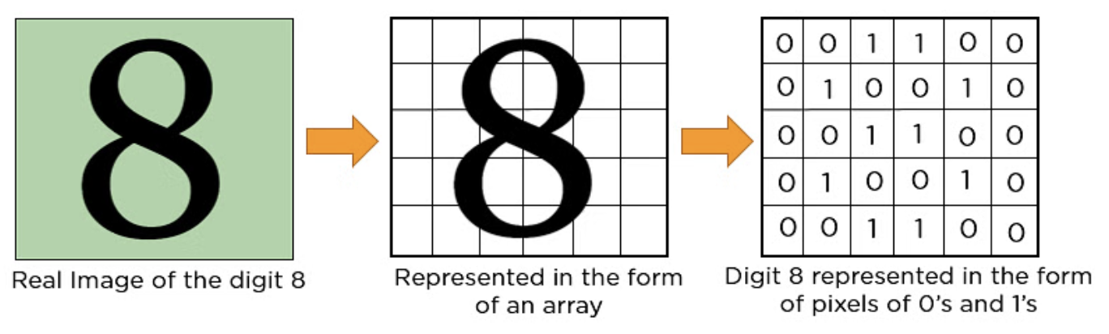
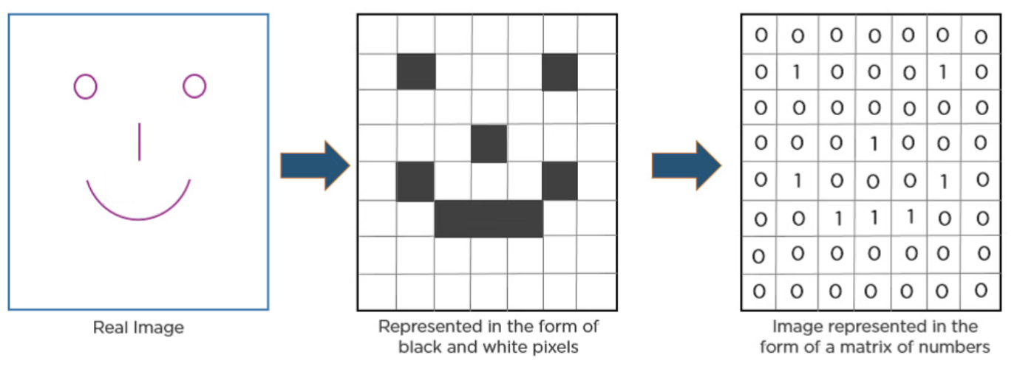
Convolution
Source

Slide 6
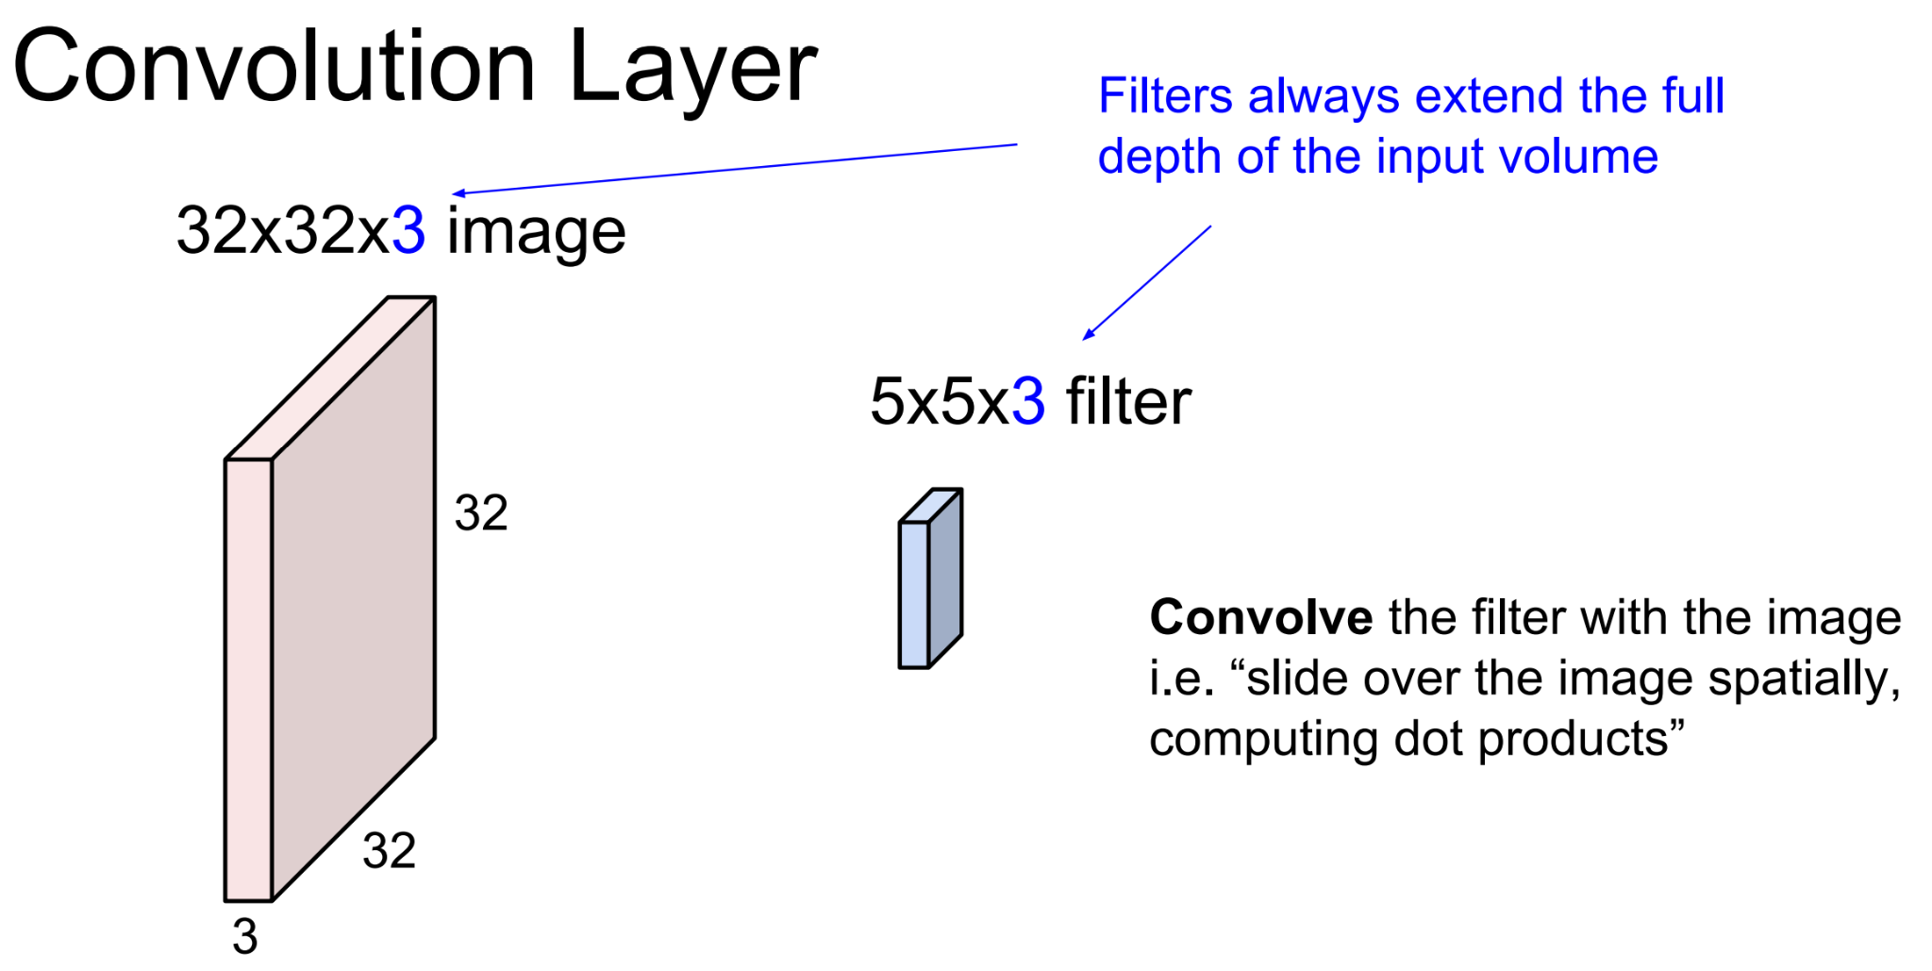
Convolution
Stanford CS231n

Slide 7
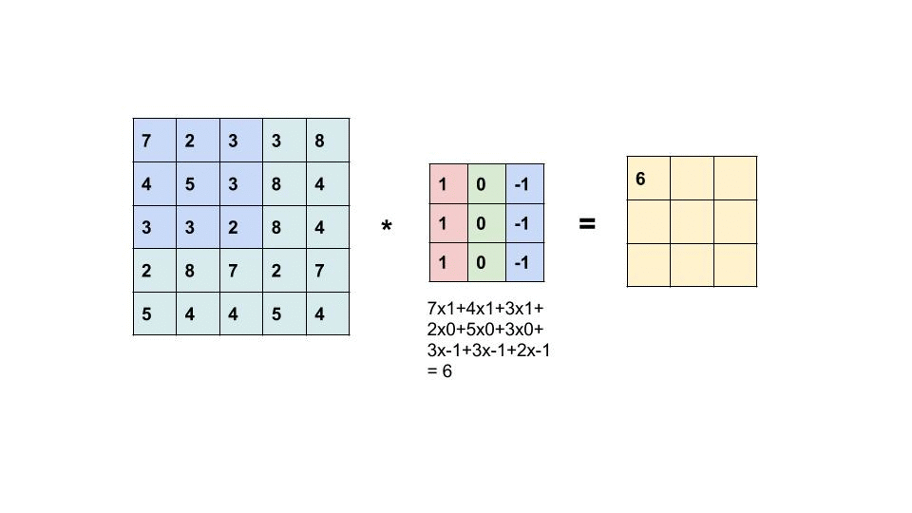
Convolution
Source (needs vpn)

Slide 8
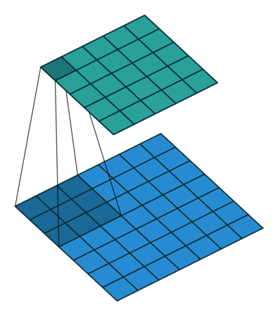
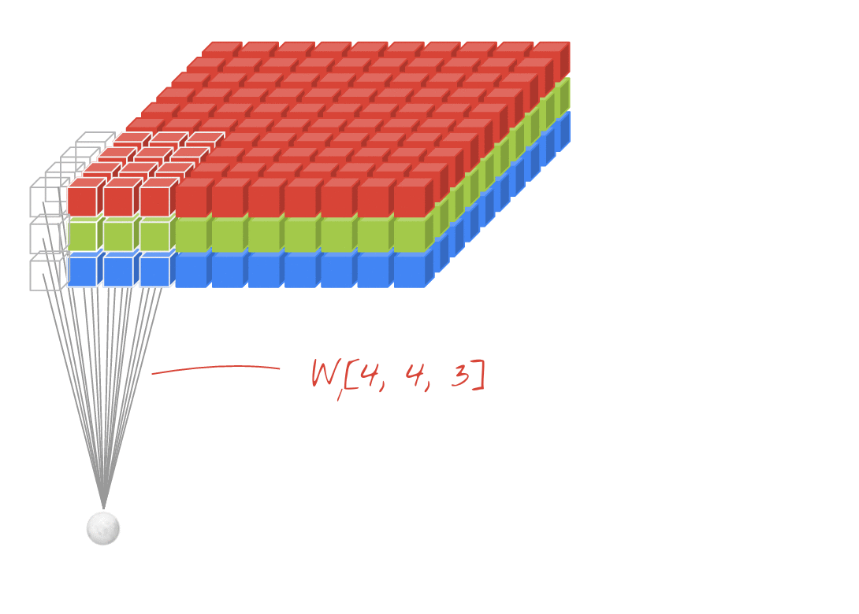
Convolution

Slide 9
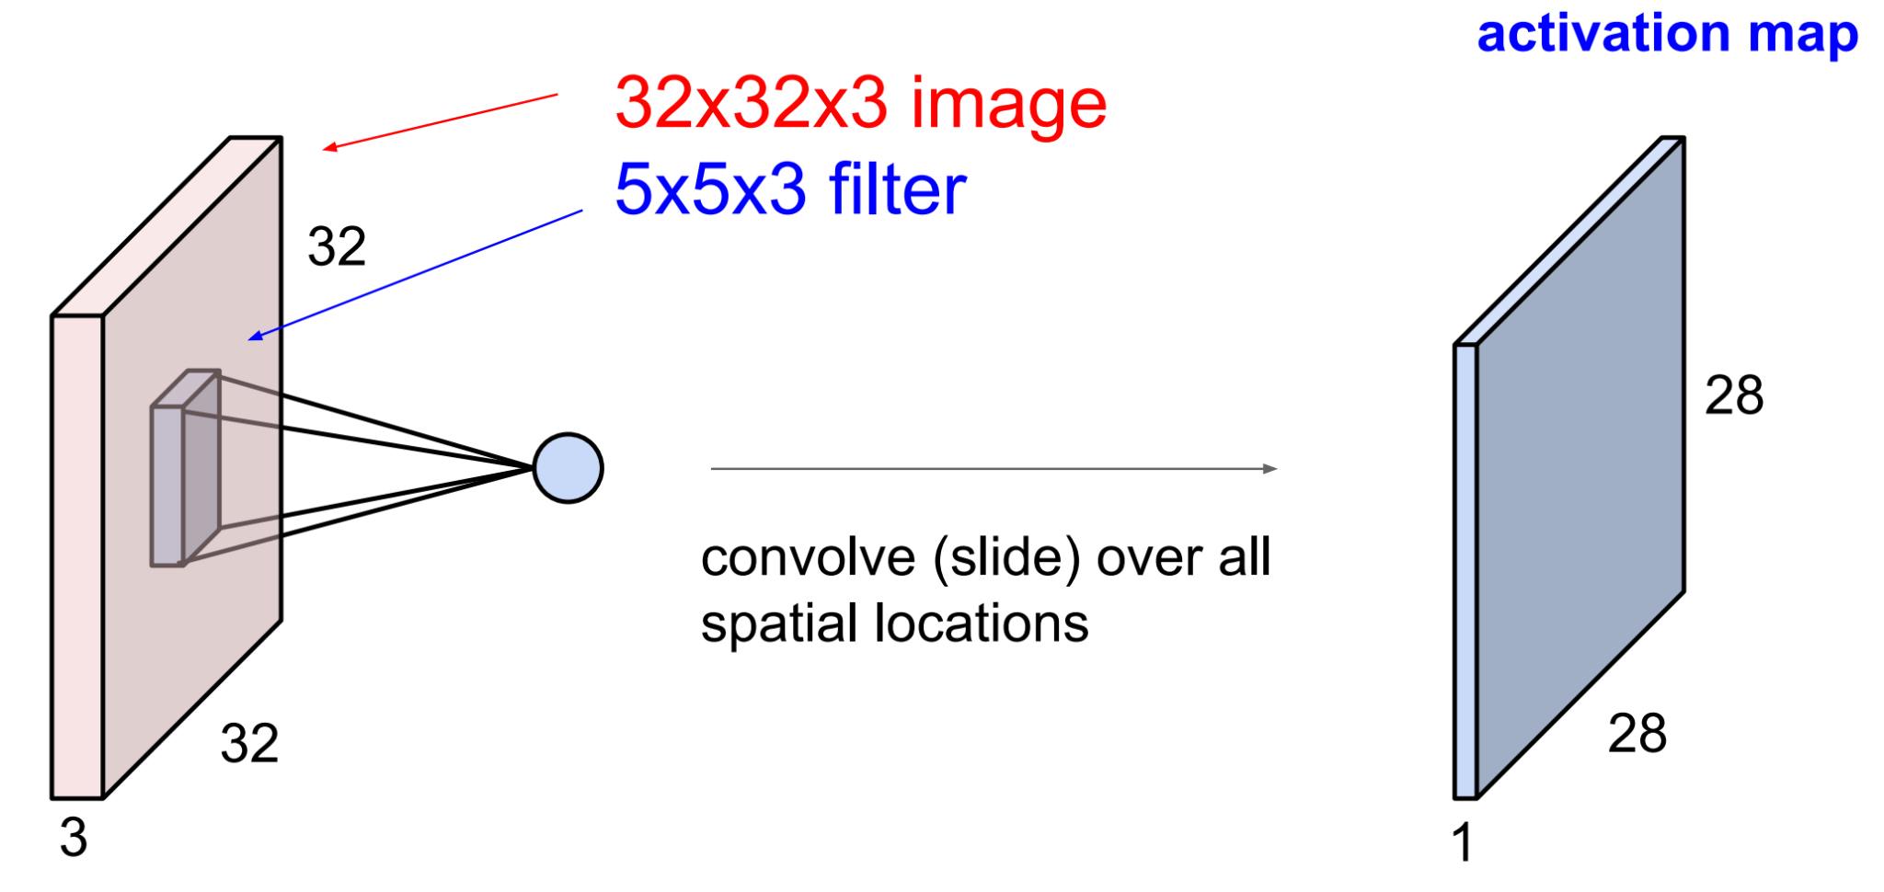
Convolution Layer
Stanford CS231n

Slide 10
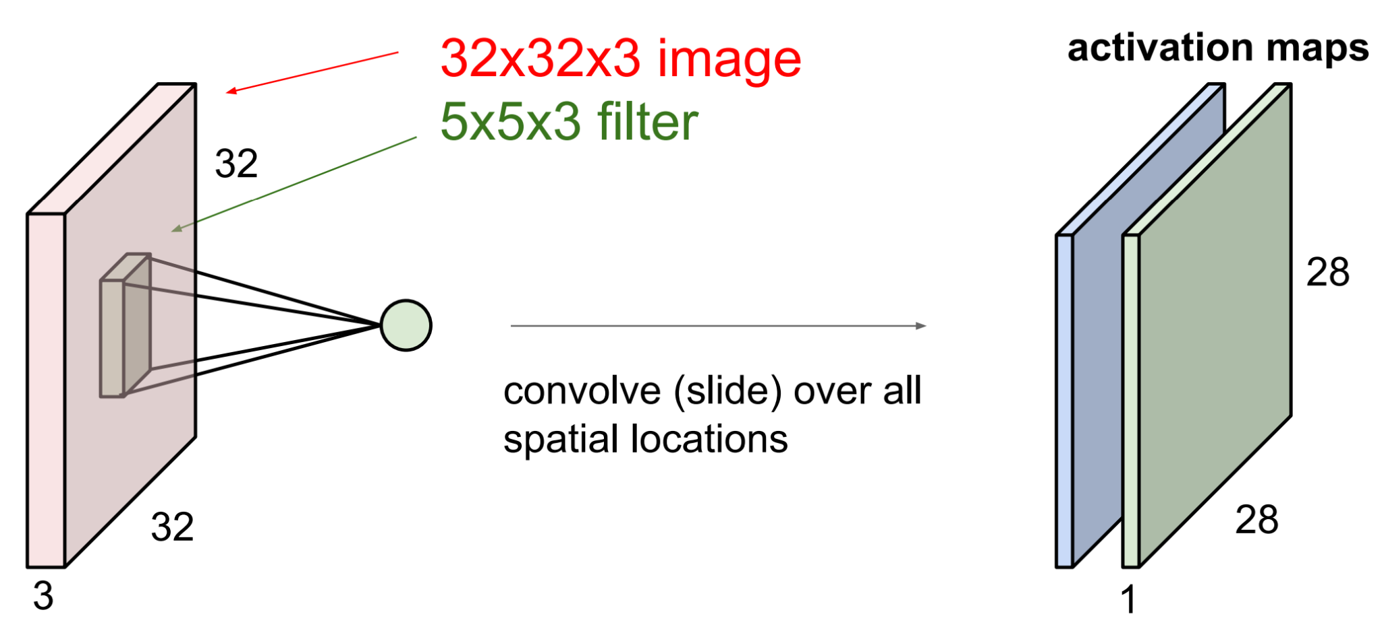
Convolution Layer
Stanford CS231n

Slide 11
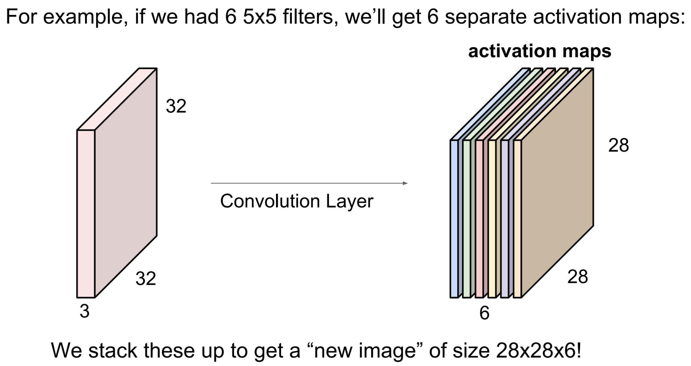
Convolution Layer
Stanford CS231n

Slide 12
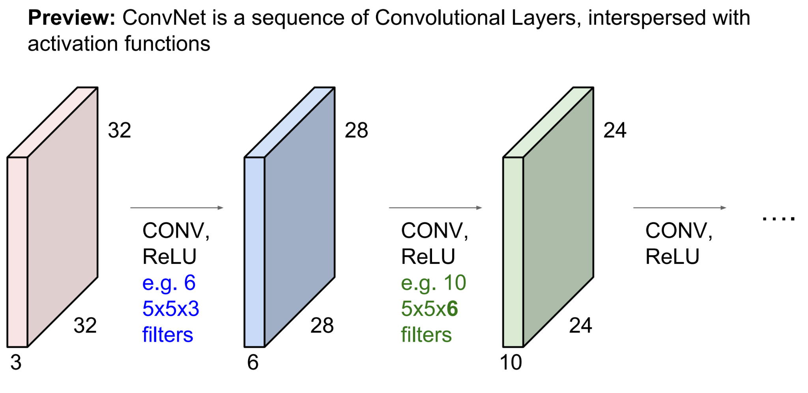
Convolution Layer
Stanford CS231n

Slide 13
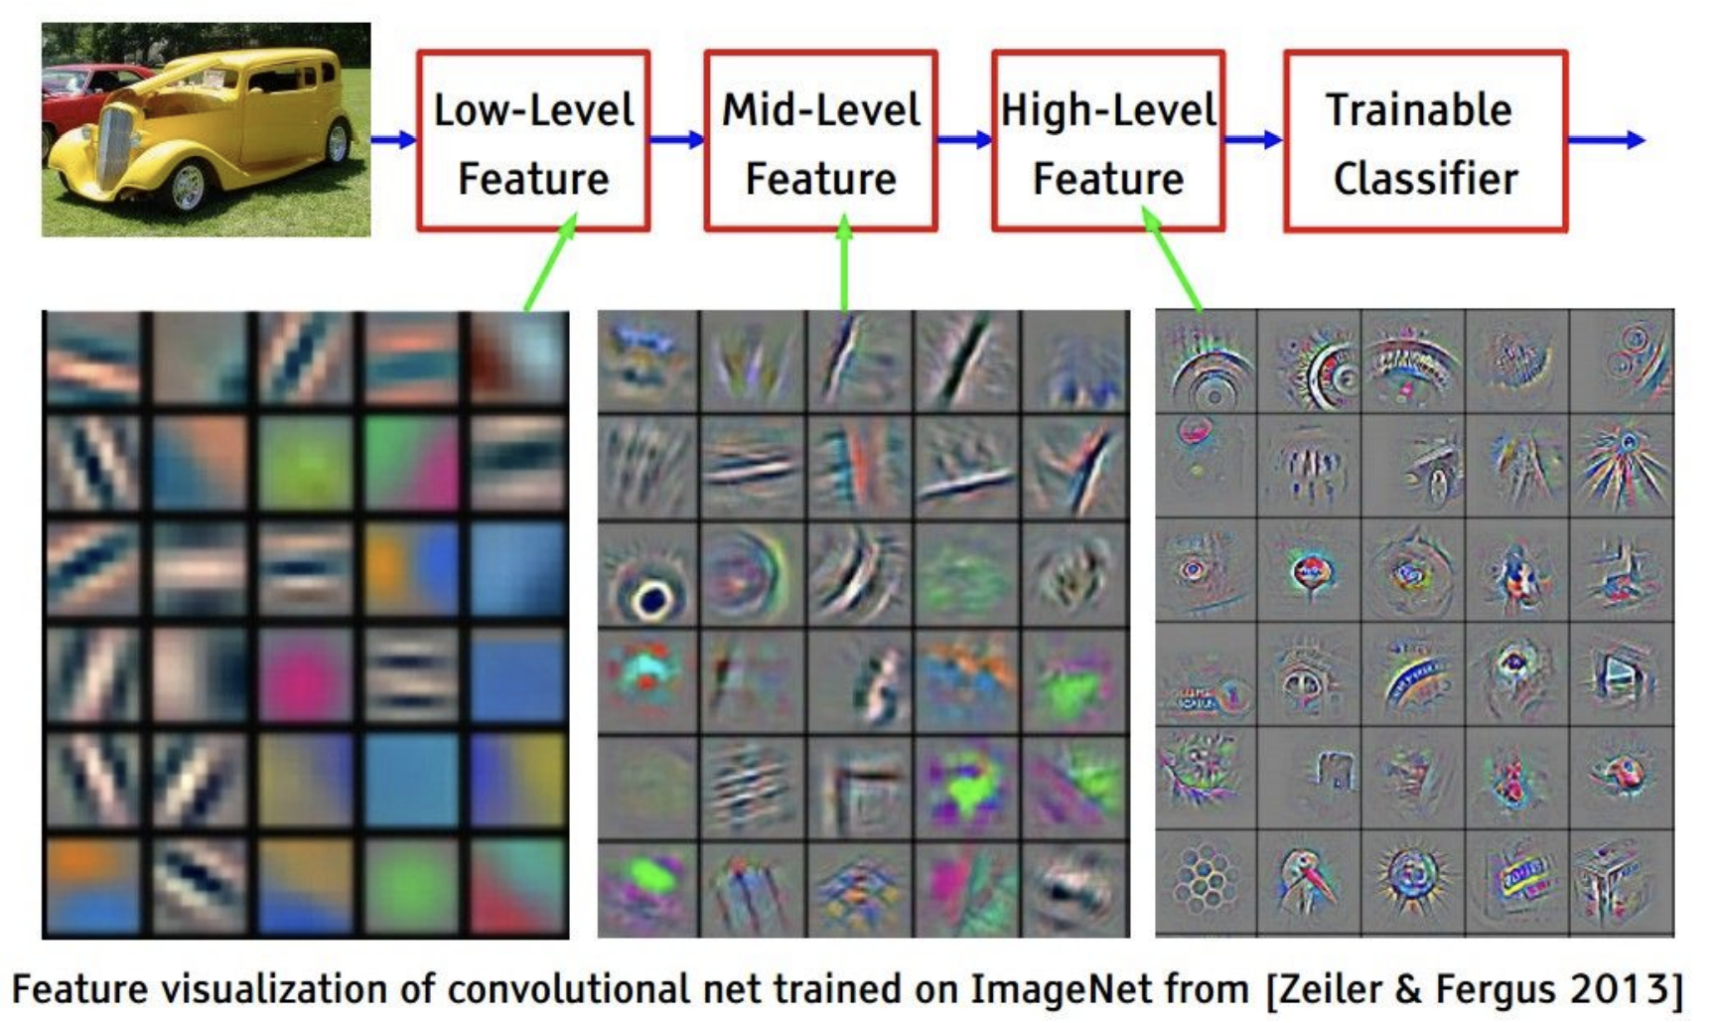
Convolution Network
Stanford CS231n

Slide 14
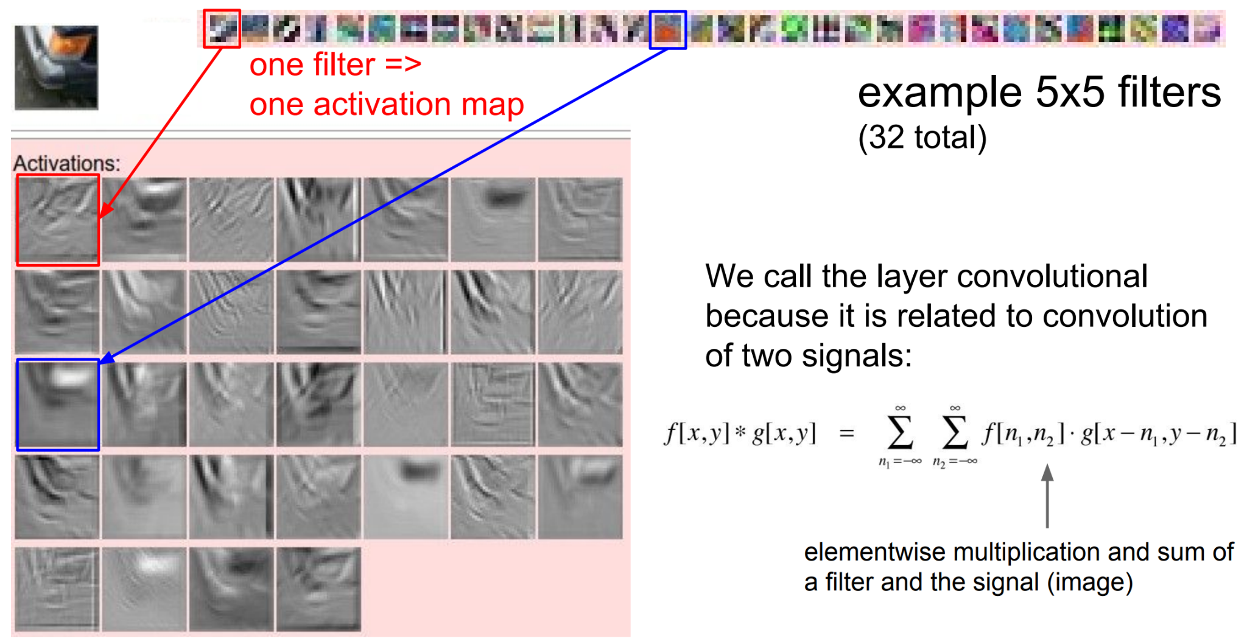
Convolution Network
Stanford CS231n

Slide 15
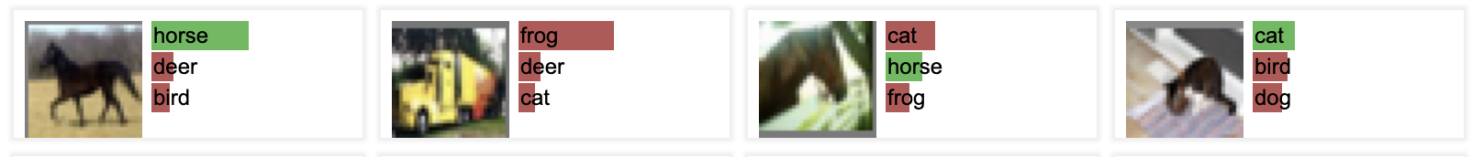
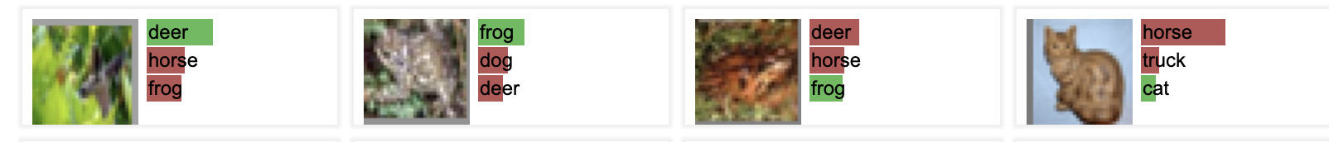
Convolution Network
ConvNetJS CIFAR-10 demo

Slide 16

Padding

Slide 17

Strides

Slide 18

Dilation

Slide 19
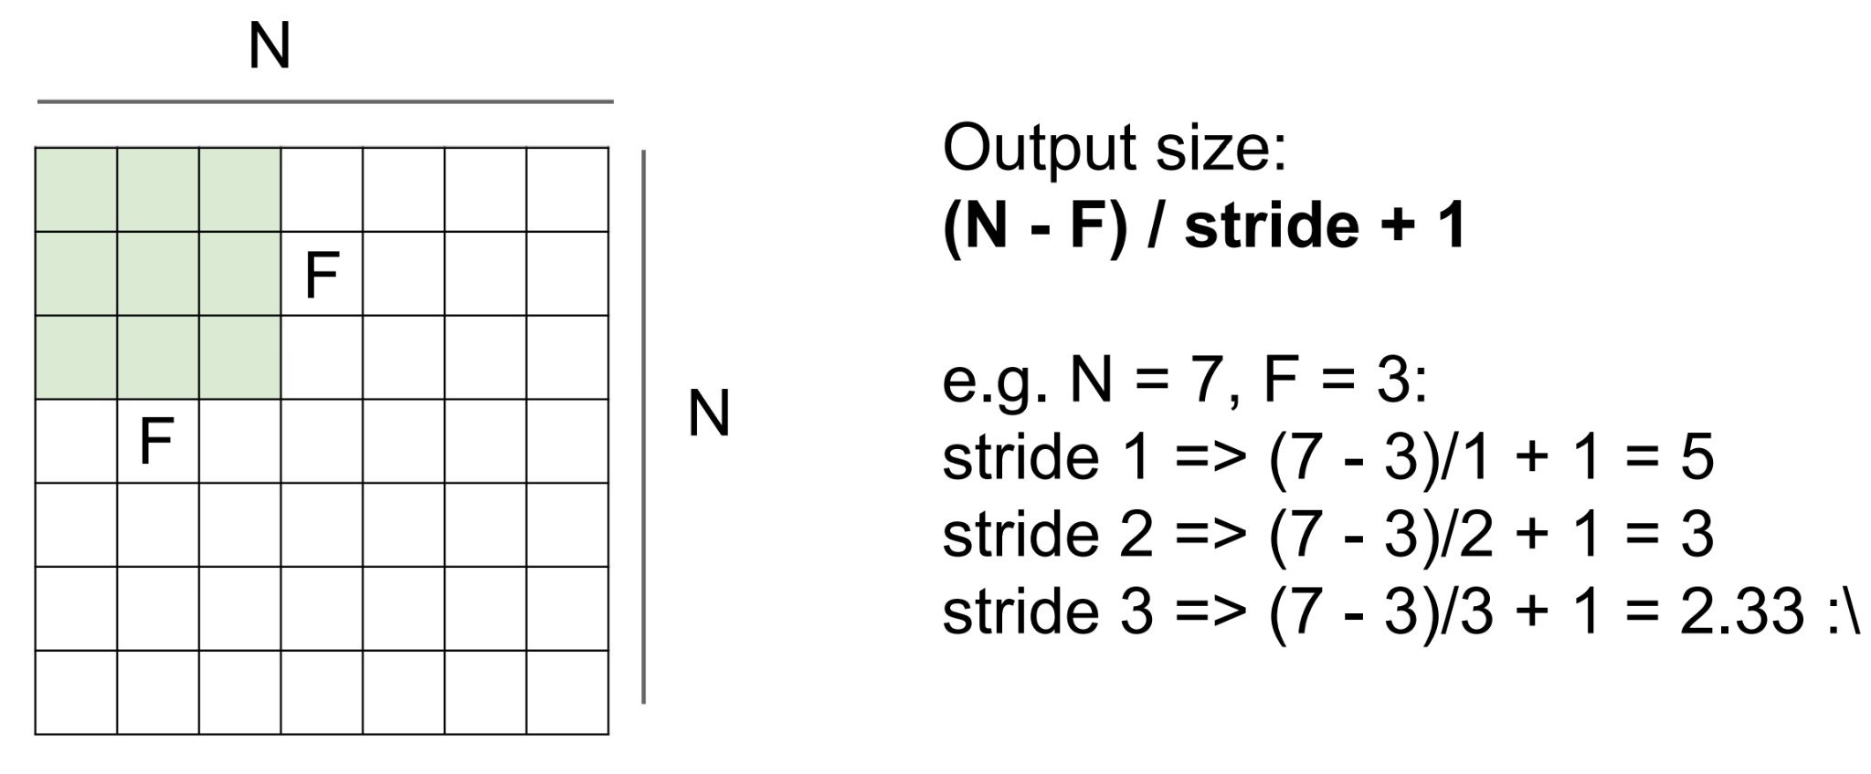
Output image formula
Stanford CS231n

Slide 20
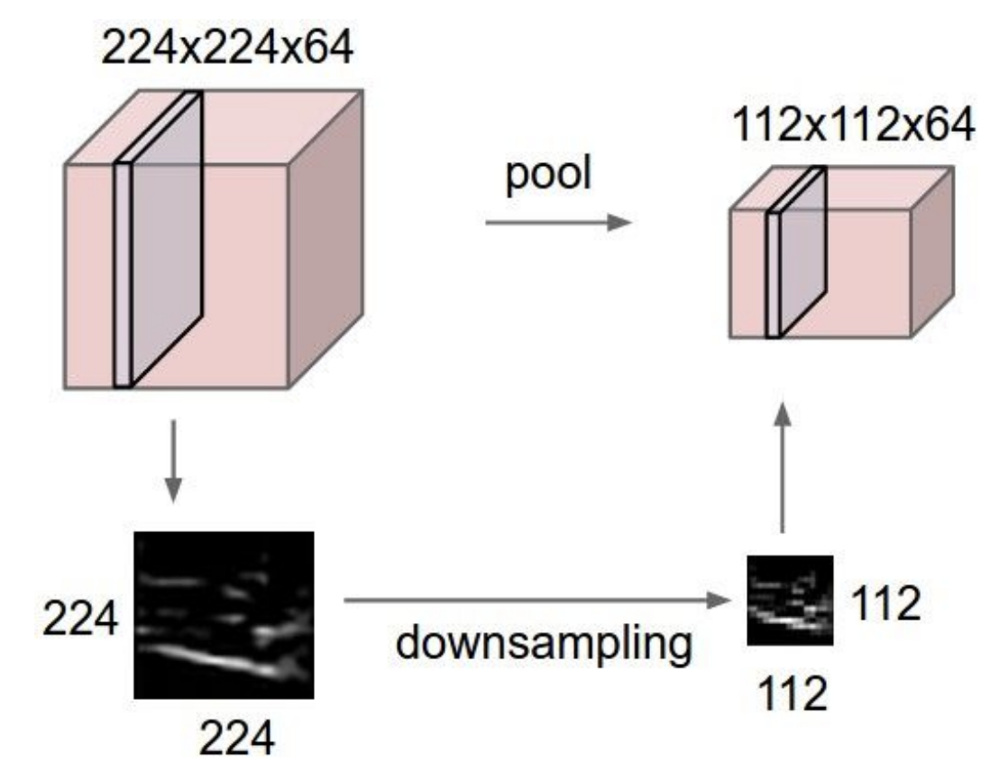
Pooling Layer
makes the representations smaller and more manageable
operates over each activation map independently
Stanford CS231n

Slide 21
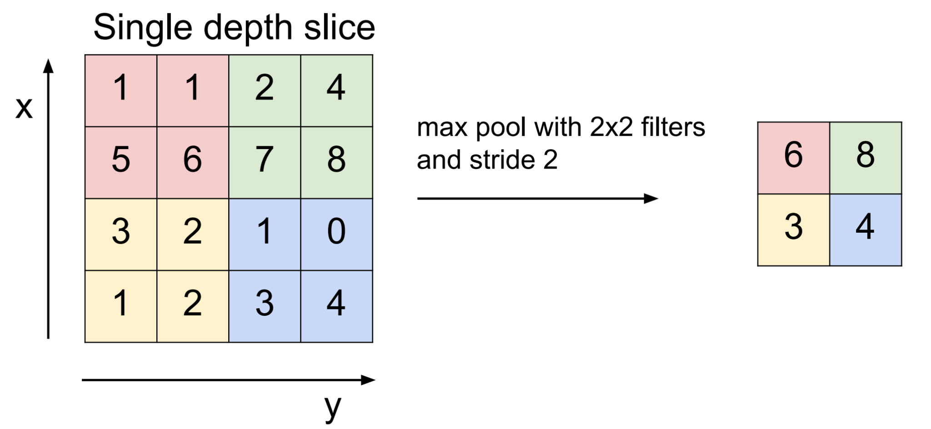
MaxPooling
Stanford CS231n

Slide 22
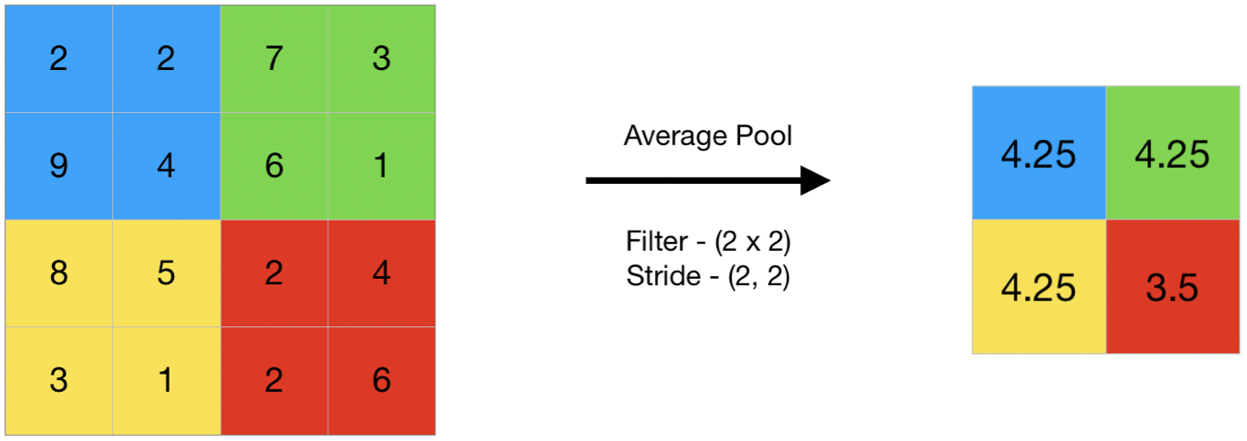
AvgPooling
Source

Slide 23
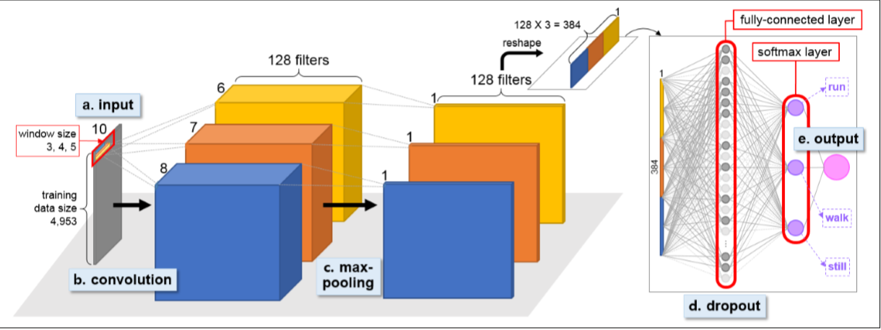
Fully Connected Layer
Source

Slide 24
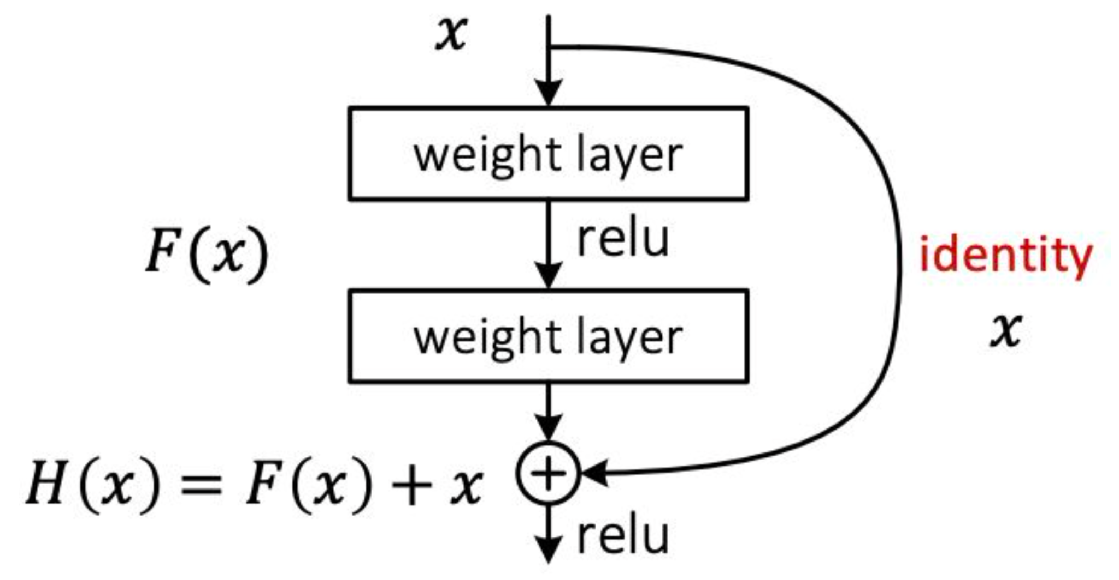
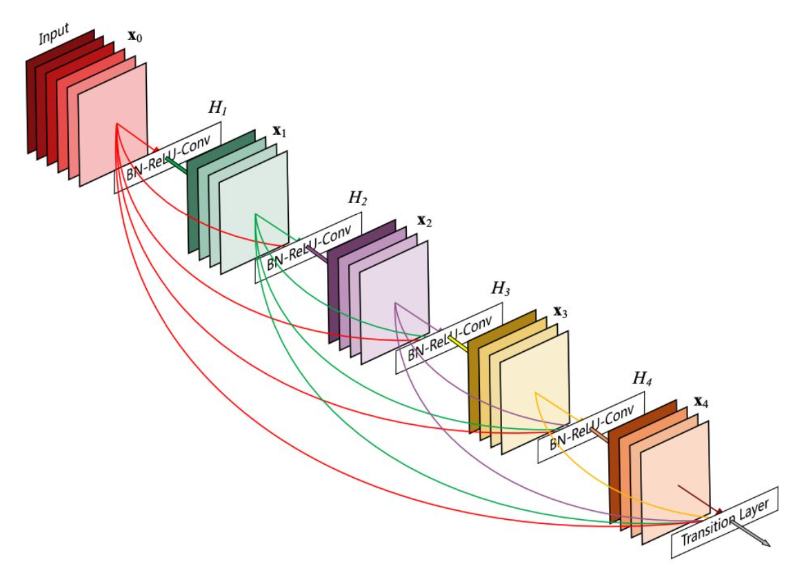
Residual Block
Girafe AI

Slide 25
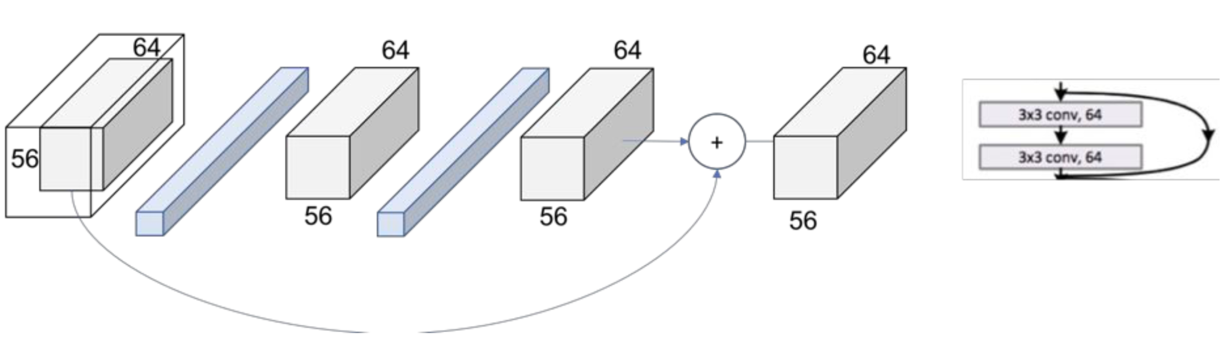
Residual Block
Girafe AI

Slide 26
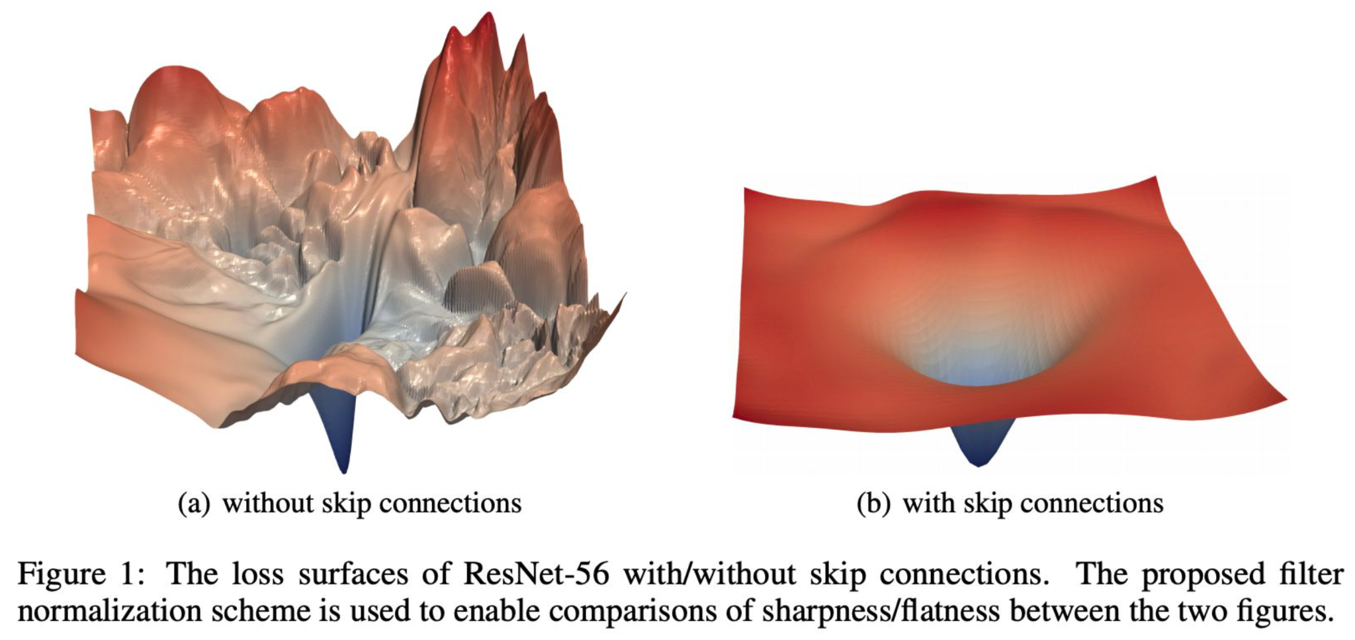
Residual Block
Visualizing the Loss Landscape of Neural Nets (NeurIPS 2018)

Slide 27
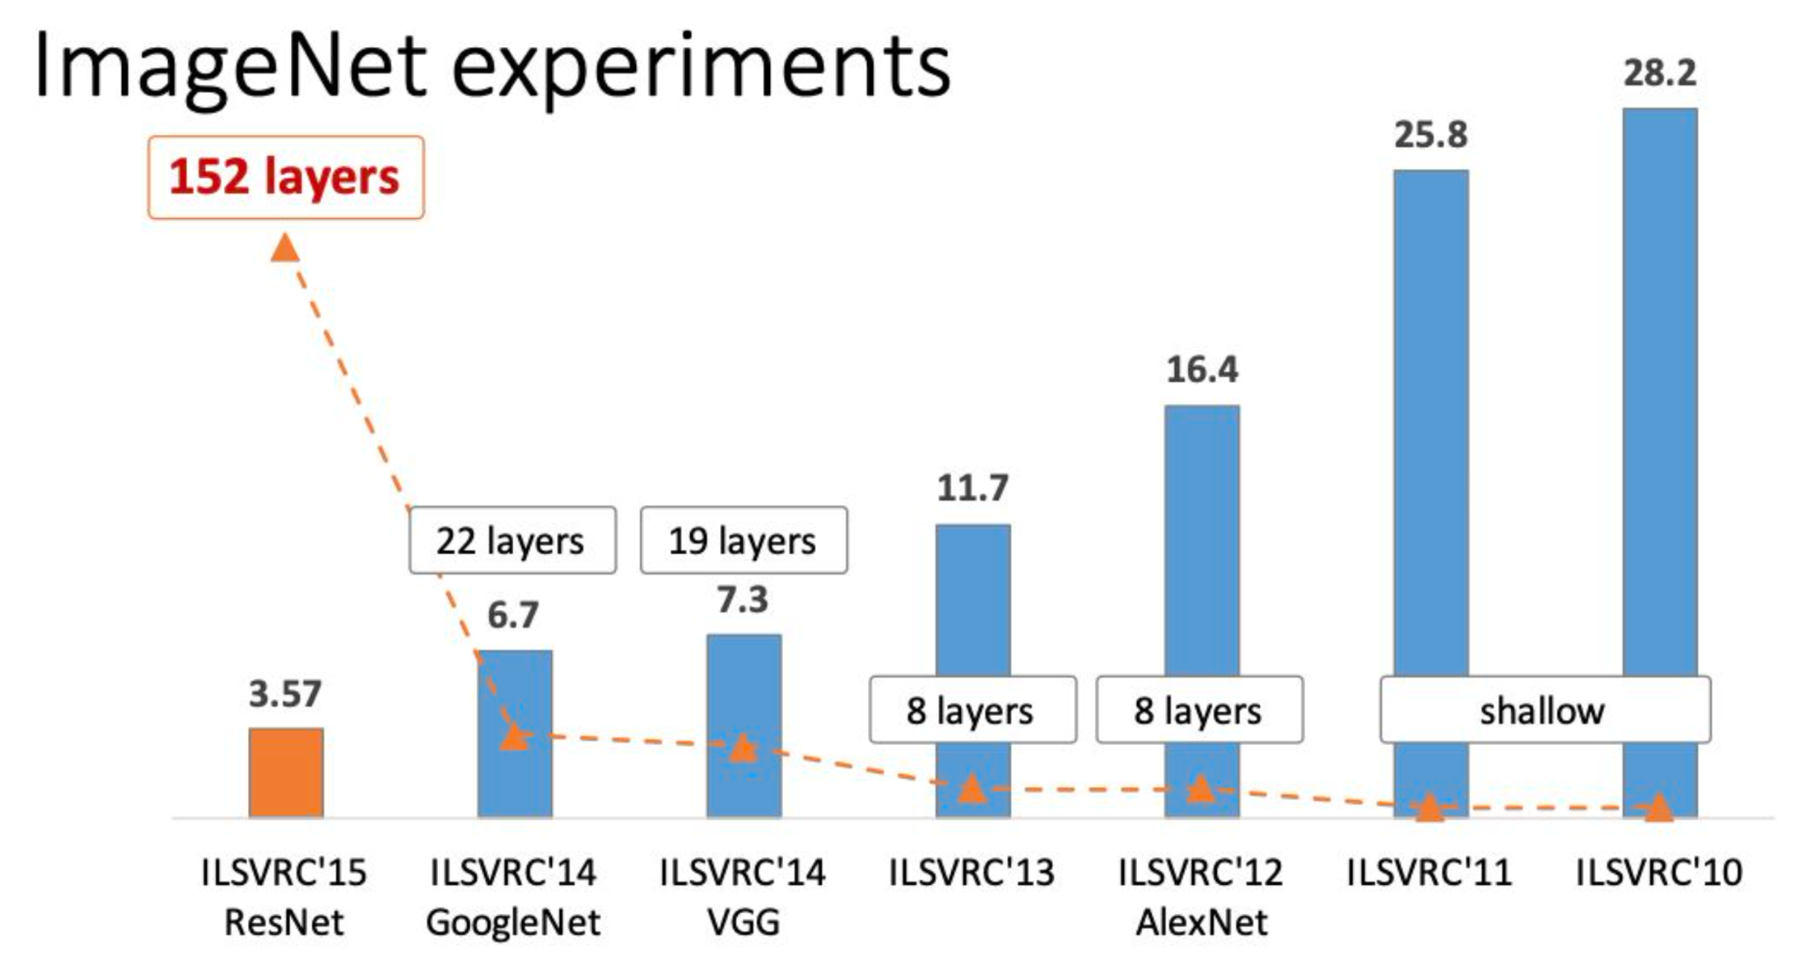
ResNet
Girafe AI

Slide 28
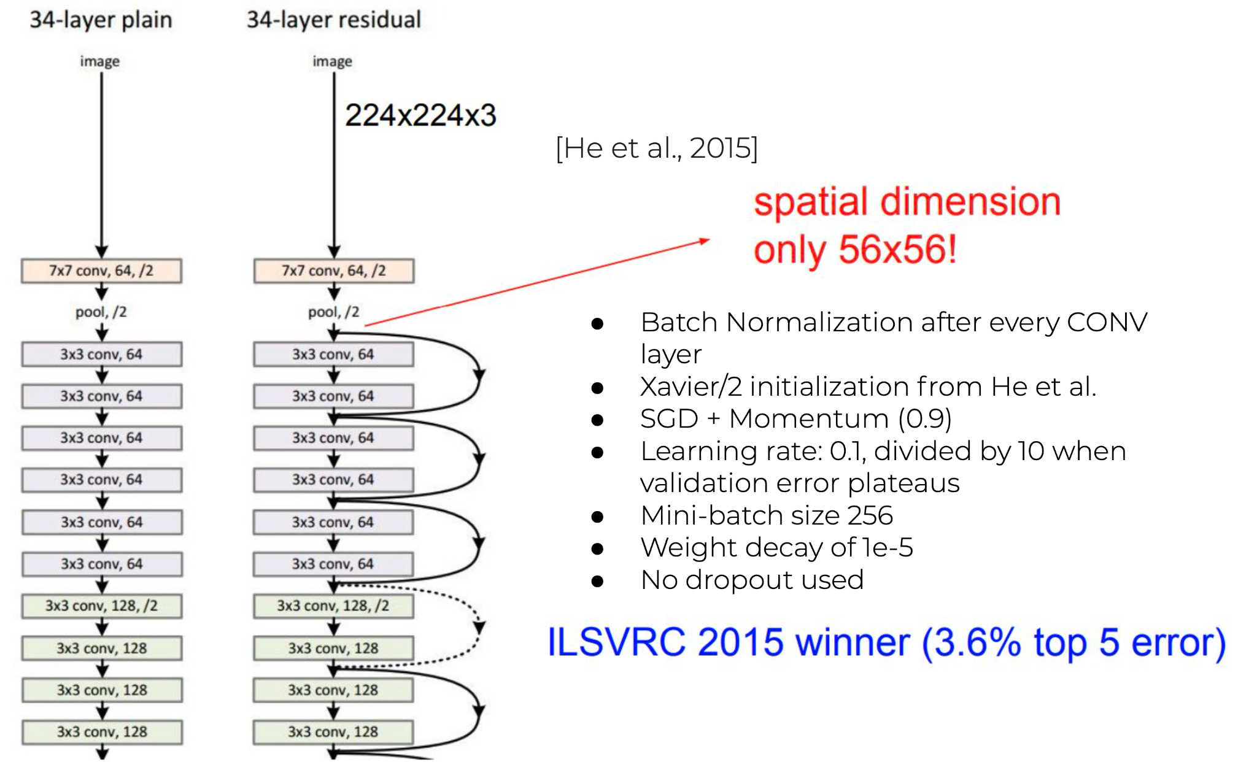
ResNet
Girafe AI

Slide 29
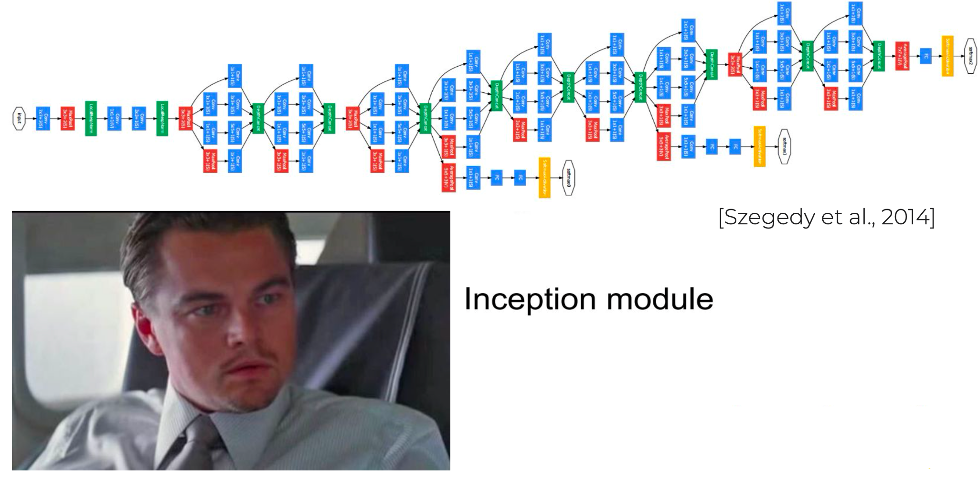
GoogleNet
Girafe AI

Slide 30
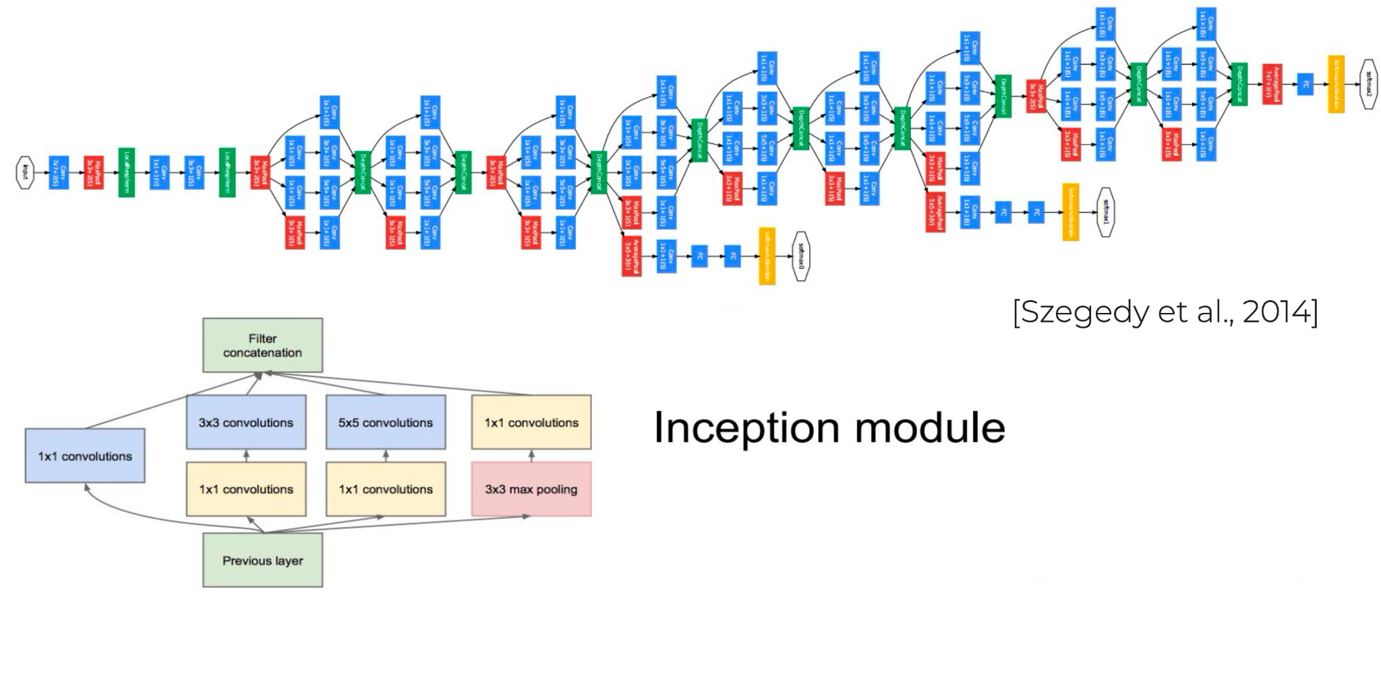
GoogLeNet
Girafe AI

Slide 31
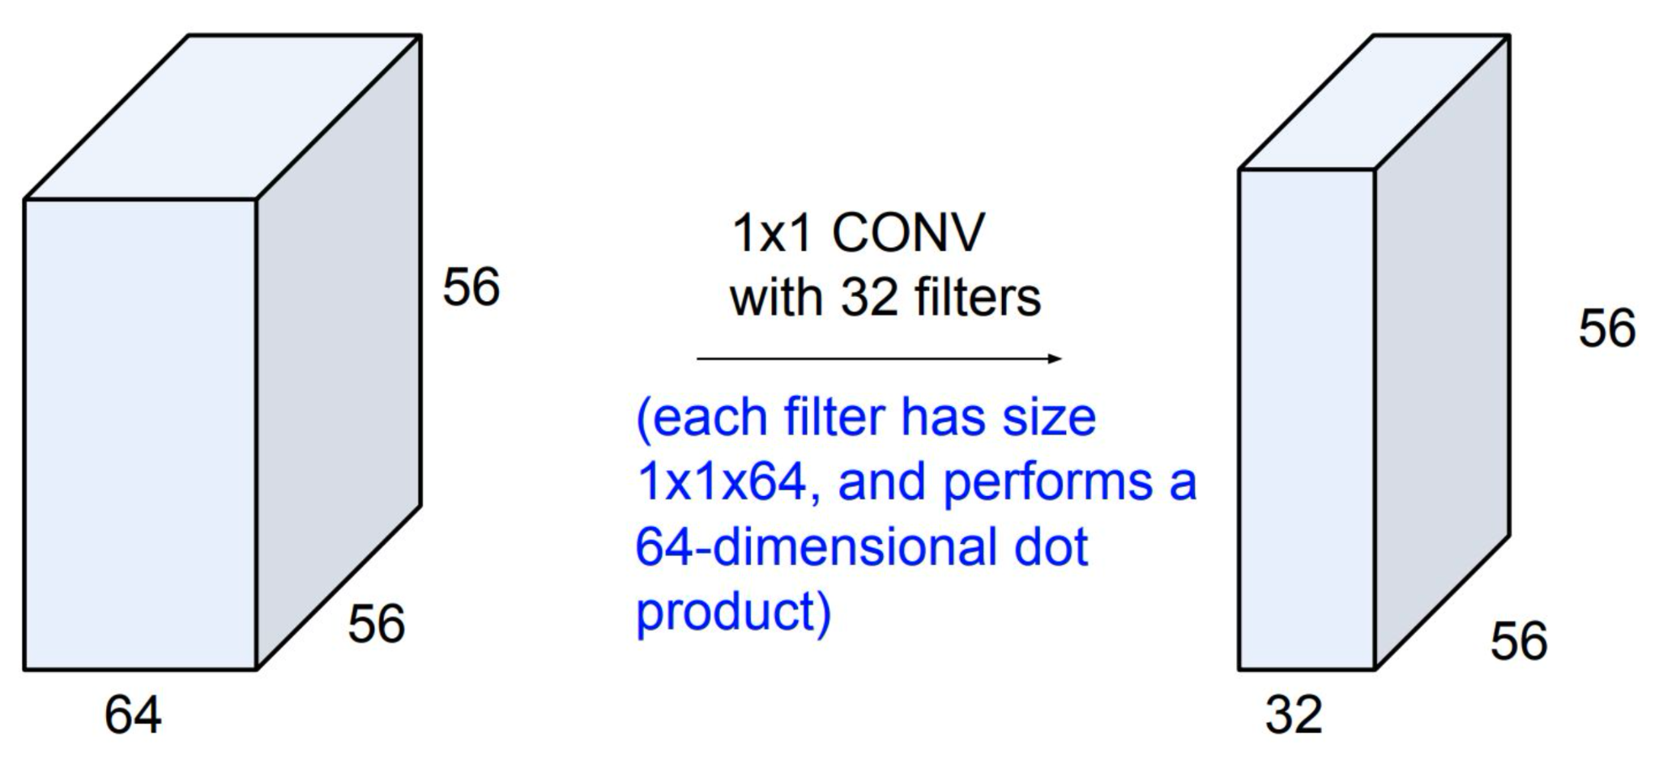
GoogLeNet
Girafe AI

Slide 32
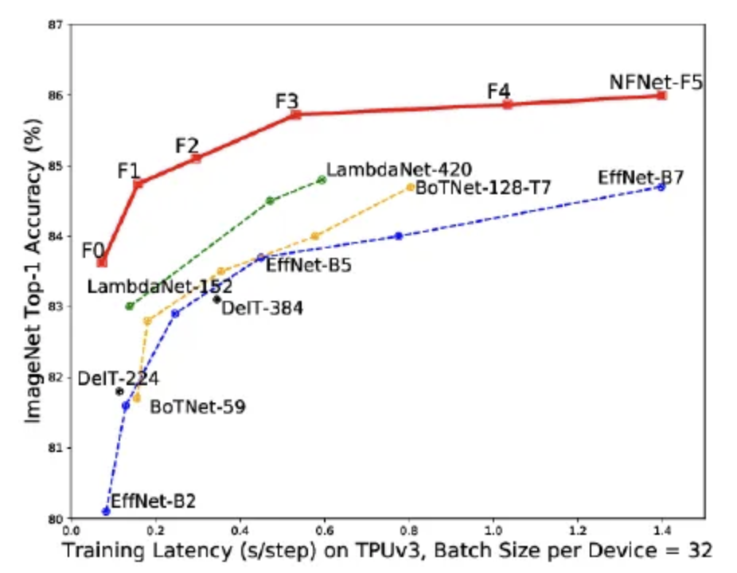
Normalizer-Free (NFNets) from DeepMind
New Adaptive Gradient Clipping (AGC) - the ratio of the norm of the gradients G1 to the norm of the weights W1 of layer 1
Family of Normalizer-free ResNets, NF-Nets
arXiv:2102.06171 , Medium (vpn need)

Slide 33
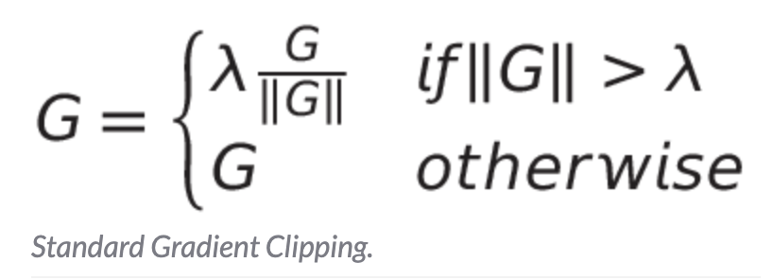
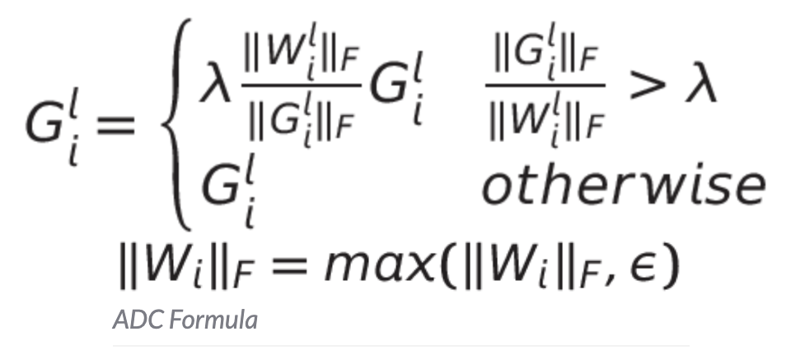
Normalizer-Free (NFNets) from DeepMind
arXiv:2102.06171 , Medium (vpn need)

Slide 34
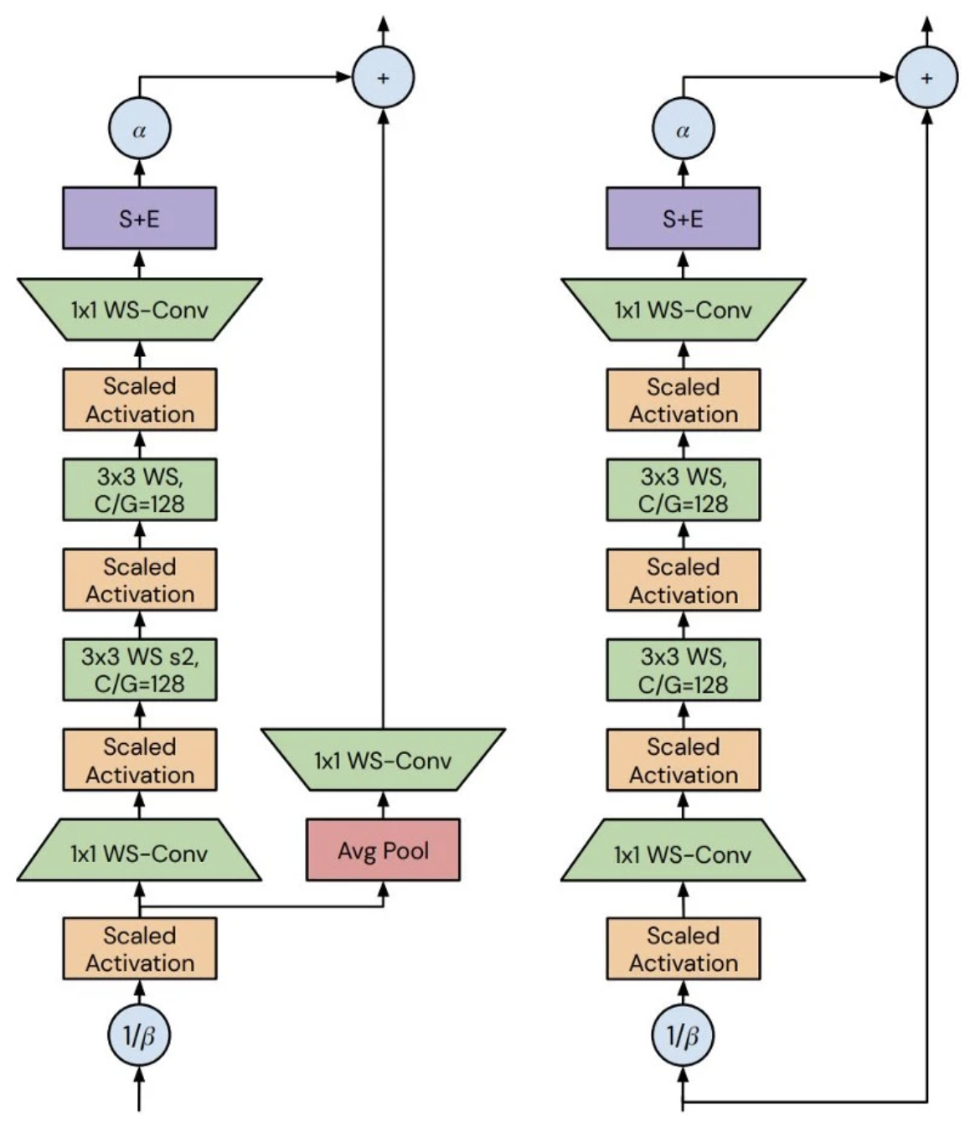
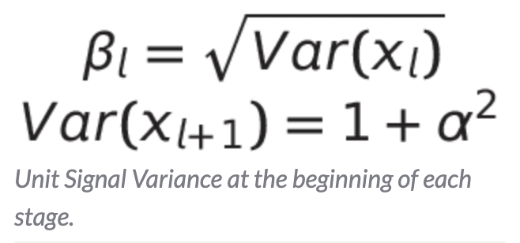
Normalizer-Free (NFNets) from DeepMind
Squeeze & Excite layer which globally average pools the activation, applies two linear layers with an interleaved scaled non-linearity to the pooled activation, applies a sigmoid, then rescales the tensor channel-wise by twice the value of this sigmoid
arXiv:2102.06171 , Medium (vpn need) , AppliedSing

Slide 35
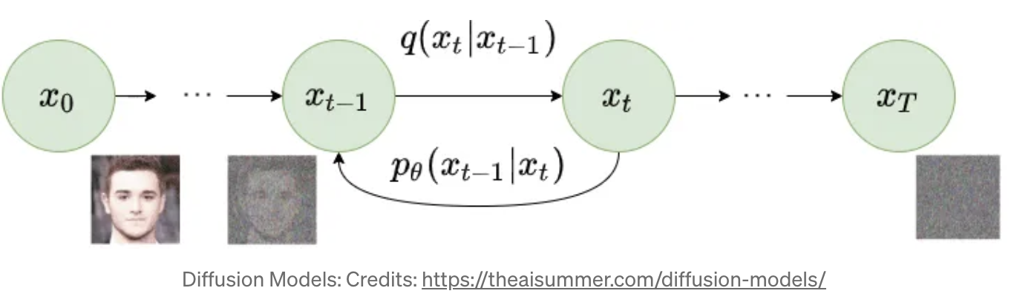
Diffusion Models
Forward diffusion process — The forward diffusion process is the Markov chain of diffusion steps in which we slowly and randomly add noise to the original data.
Reverse diffusion process — The reverse diffusion process tries to reverse the diffusion process to generate original data from the noise.
Medium (vpn need)

Slide 36

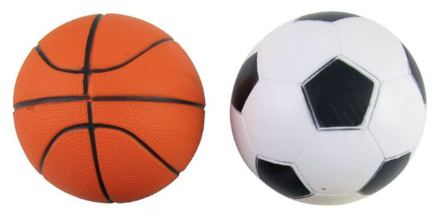
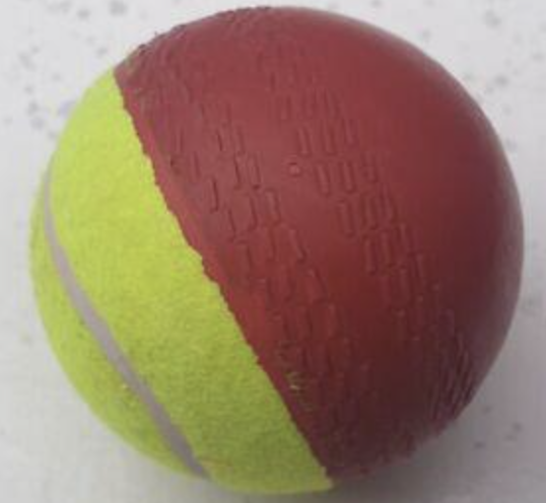
Homework-Competition
Sports balls - multiclass image classification
Over 9,000 images of sports balls from 15 different sports

